Slide 1
Woodland Public Schools
Facilities and Safety Report
March 2021

Slide 2
FACILITIES REPORT
Completed updates to the community rentals program for the sports fields, in light of the COVID pandemic. Fields became available to the community the week of March 22nd. A unique COVID form was created (COVID Disclosure and Release form) to identify additional requirements and mitigate risk to the District, while the community conducts programs on school property.
Completed the final inspections on the TEAM High portable addition and released the building to TEAM High staff.
Set WHS and WMS rooms to the new 3 foot distancing measure, in order to accommodate the return of all students to the High School and Middle School.
Kicked off the summer worklist this week including carpet, exterior painting, scheduled preventive maintenance and other projects scheduled for the 2021 summer.
After 33 years of faithful service, the IT van was retired and a new (new to us) van was purchased.
The back up Yale water pump should arrive the week of April 19th. Once received we will be able to restore the system back to 24-hour service.
We will be carefully observing the COVID numbers and guidance from DOH throughout the next few months to identify and procure the needed PPE for school in the fall (if needed).

Slide 3
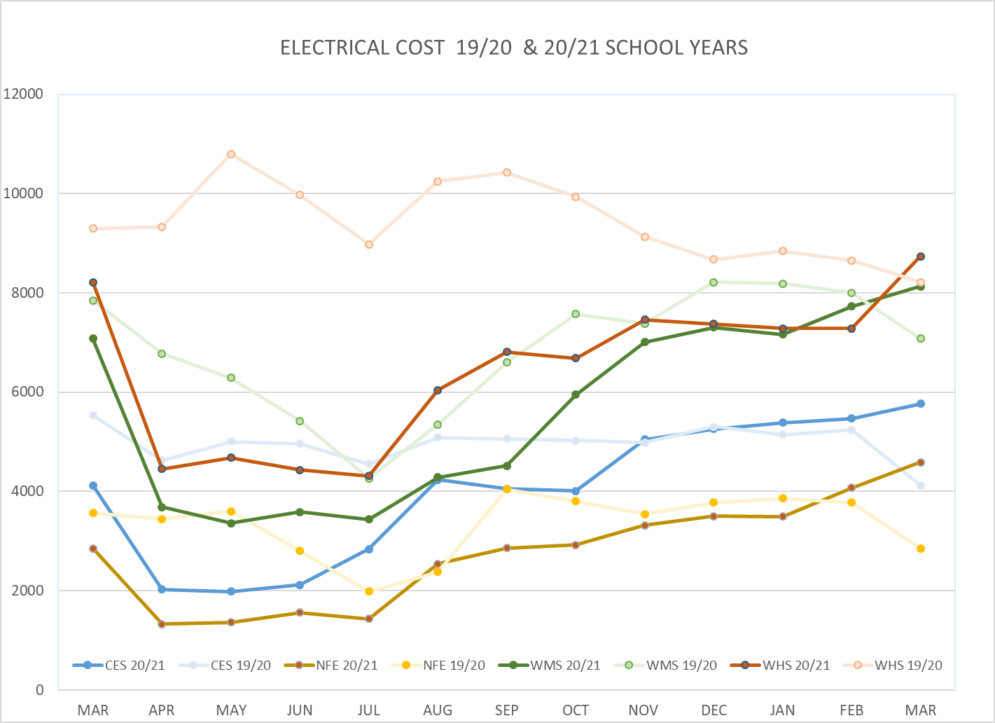
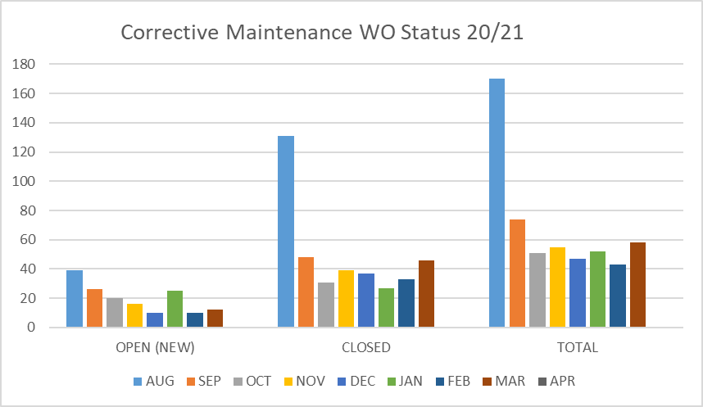
FACILITY CHARTS – POWER COST AND WORK ORDER STATUS

Slide 4
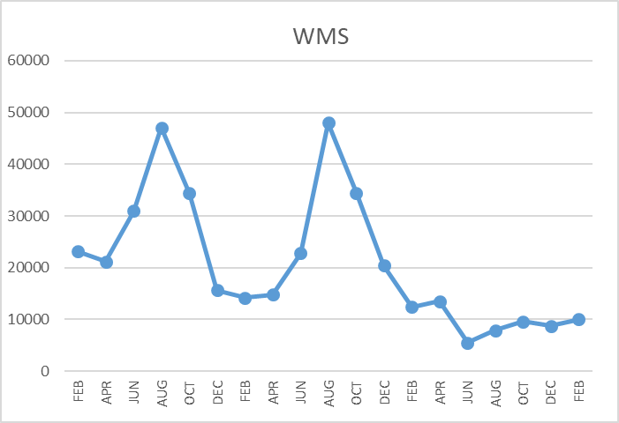
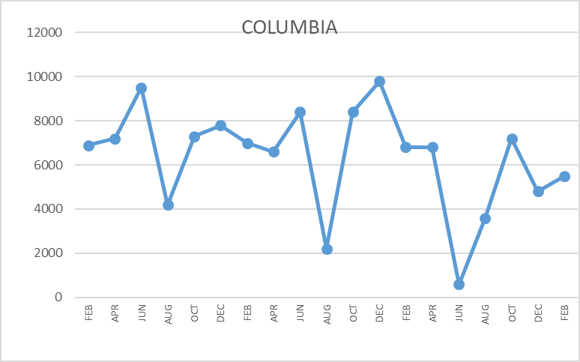
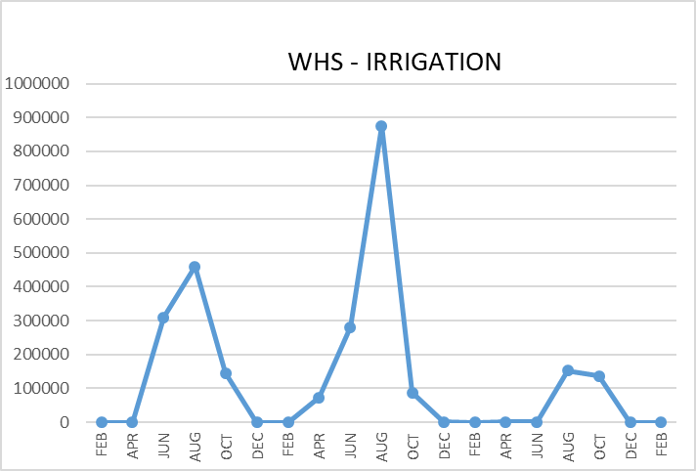
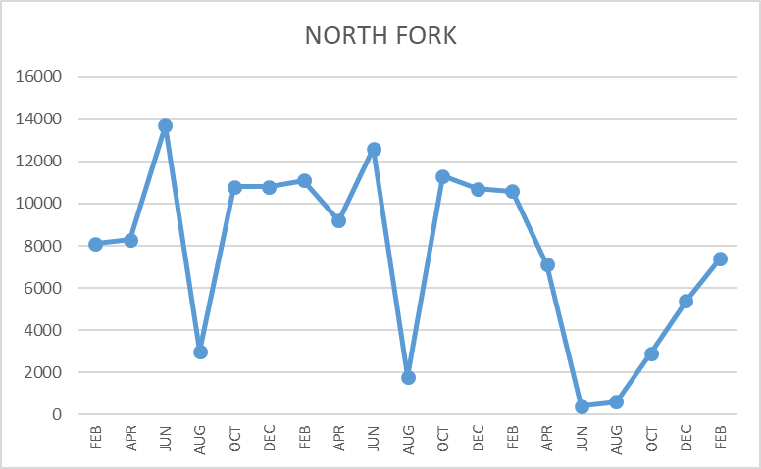
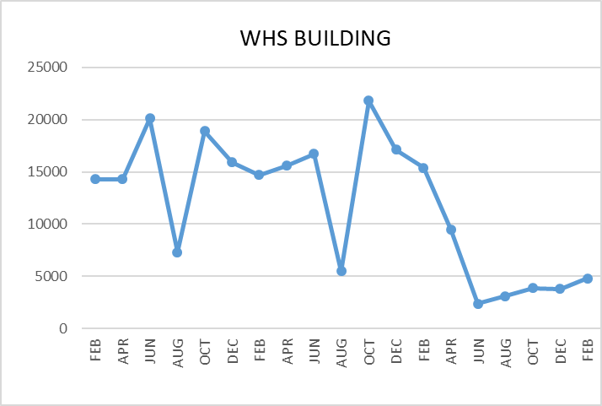
FACILITY CHARTS WATER USAGE WHS, NFES, WMS, CES
Note
Water charts are updated every two
months. Next update to these charts in the May 2021 report
The WMS chart includes the following 7 meters: 755 Park high and low flow, BO and Team High, PIT house, bus barn, athletic field and DO. All of these meters are totaled on the WMS graph, but each data point is recorded separately to aid in identifying leaks.

Slide 5
Safety Summary
Staff Accidents/Incidents
Yale – Employee slipped on wet floor mat- bruised hand.
Student Accidents/Injuries
None

